Slide 1
For Live Session
Unit 11

Slide 2
Activity One: SES (1 hour)
install.packages("fpp")
library(fpp)
# 1. SES MODEL FOR AUS AIR
data(ausair)
#returns a ts object
air = window(ausair, start = 1990, end = 2004)
# Always plot the data first!
plot(air,ylab = "Airline Passegners", xlab = "Year", main = "Airline Passengers")
#fit 3 different simple exponential smoothing models ... how are they different?
# what does the h paramter do?
fit1 = ses(air, initial = "simple",alpha = .2,h = 3)
fit2 = ses(air,initial = "simple",alpha = .6, h = 3)
fit3 = ses(air, h = 3) #defaults
# the forecast package has a nice accuracy funciton with various metrics just pass it the
# the model and the data! (This is the "training" data)
accuracy(fit1, ausair)
accuracy(fit2, ausair)
accuracy(fit3, ausair)
#Reset the plot
plot(air,ylab = "Airline Passegners", xlab = "Year", type = "o", xlim = c(1990, 2008),ylim = c(15,50), main = "Airline Passengers")
#Plot the estimated values from the models .. the "fitted" values are the training values.
lines(fitted(fit1), col = "blue", type = "o")
lines(fitted(fit2), col = "red", type = "o")
lines(fitted(fit3), col = "green", type = "o")
# the $mean values are the forecasts.
lines(fit1$mean, col = "blue", type = "o")
lines(fit2$mean, col = "red", type = "o")
lines(fit3$mean, col = "green", type = "o")
# These are the actual values! Compare visually with the forecasts!
air2008 = window(ausair, start = 1990, end = 2007)
points(air2008, type = "o")
# Compare the forecasts with the actual values with various fit metrics.
accuracy(fit1, air2008)
accuracy(fit2, air2008)
accuracy(fit3, air2008)
Run this code and get a feel for what it is doing. Feel free to change it up and just learn by playing. Create a slide that allows you to discuss the output / analysis / result.

Slide 3
Activity Two: Holt Linear (1 hour)
#2 Holt's Linear Trend Model for AUS AIR
fit1h = holt(air, alpha = .8, beta = .2, initial = "simple", h = 5)
fit2h = holt(air, alpha = .8, beta = .2, initial = "simple", exponential = TRUE, h = 5)
# Check out estiamted values of the "training" data from the first holt model
fitted(fit1h)
# Check out the forecast value (h of them)
fit1h$mean
# Reset the Plot!
plot(air,ylab = "Airline Passegners", xlab = "Year", type = "o", xlim = c(1990, 2009),ylim = c(15,60))
#Plot each models estimated values of the training data (Do these one by one to see the differences)
lines(fitted(fit1h),col = "blue", type= "o")
lines(fitted(fit2h), col = "red", type= "o")
#Plot each models forecasts (Do these one by one to see the differences)
lines(fit1h$mean, col = "blue", type= "o")
lines(fit2h$mean,col = "red", type= "o")
# Fit another model ... damped!
fit3h = holt(air, alpha = .8, beta = .2, damped = TRUE, initial = "optimal", h = 5)
# Plot the fitted value (estimated from triaining data)
lines(fitted(fit3h), col = "darkgreen", type= "o")
# Plot the forecasts
lines(fit3h$mean,col = "darkgreen", type= "o")
# Fit another model ... what is the difference?
fit4h = holt(air, alpha = .8, beta = .2, damped = TRUE, initial = "optimal", exponential = TRUE, h = 5)
# Plot the fitted value (estimated from triaining data)
lines(fitted(fit4h), col = "cyan", type= "o")
#Plot the forecasts
lines(fit4h$mean,col = "cyan", type= "o")
# with implicit Test set... it figures out by the time which are training and which are test.
accuracy(fit1h, ausair)
accuracy(fit2h, ausair)
accuracy(fit3h, ausair)
#with explicit Test set ... (same output)
airTest = window(ausair, start = 2005)
accuracy(fit1h, airTest)
accuracy(fit2h, airTest)
accuracy(fit3h, airTest)
#Add the actual values to visually compare forecasts to actual values
air2008 = window(ausair, start = 1990, end = 2009)
points(air2008, type = "o")
Next, this is similar code with a different model (Holt with linear trend.) Again, run this code and get a feel for what it is doing. Feel free to change it up and just learn by playing. Create a slide that allows you to discuss the output / analysis / result.

Slide 4
Activity Three: Holt Seasonal (1 hour)
#3. Seasonal Trend
#Load the data
data("austourists")
# Read about the dataset!
?austourists
# Always plot the data first!
plot(austourists)
# returns a ts object.
aust = window(austourists,start = 1999, end = 2004)
#fit an additive and multiplicative model
fit1s = hw(aust,seasonal = "additive",h = 40)
fit2s = hw(aust,seasonal = "multiplicative",h = 40)
#Plot the original data
plot(aust,ylab = "Australian Tourists", xlab = "Year", type = "o", xlim = c(1999, 2014),ylim = c(15,60))
#add the fitted values from the model (of the training data)
lines(fitted(fit1s),col = "blue", type= "o")
lines(fitted(fit2s), col = "red", type= "o")
#Now add the forecasts (add these one at a time)
lines(fit1s$mean, col = "blue", type= "o")
lines(fit2s$mean,col = "red", type= "o")
#Compare the accuracy
accuracy(fit1s,austourists)
accuracy(fit2s,austourists)
#add the actual values to visually compare the forecasts to the actual values.
points(austourists, type = "o")
We are changing the data this time. Still just learn by playing with the code and looking closely at the input arguments and the output. Create a slide that allows you to discuss the output / analysis / result. Also, record any questions that pop up while you are playing. We can discuss them in live session.

Slide 5
Activity Four: Full Analysis(3-5 hours)
Temperature Data Using the maxtemp dataset granted by loading the fpp2 package, there are maximum annual temperature data in Celsius. For more information, use help(maxtemp). To see what you’re looking at, execute the command in ‘Examples’ in the help document.
We are only concerned with information after 1990. Please eliminate unwanted information or subset information we don’t care about.
Utilize SES to predict the next five years of maximum temperatures in Melbourne. Plot this information, including the prior data, the SES predictions and the forecast. Add the predicted value line across 1990-present as a separate line, preferably blue. So, to review, you should have the data, the predicted value line overlaying it, and a forecast through 2021, all on one plot. Find the AICc and BIC of this fitted model. You will use that information later.
Now use a damped Holt’s linear trend to also predict out five years. Make sure initial=“optimal.” As above, create a similar plot to the one you just completed for the SES model, but use the Holt fit instead.
Compare the AICc and BIC of the ses() and holt() models. Which model is better here?
Calculate and compare the RMSE from the ses() and holt() models. Which one performs better with respect to this metric?

Slide 6
Bonus: The Wands Chooses the Wizard
Fun with a great plotting function / package… Dygraphs!
Utilize the dygraphs library. Read in both Unit12TimeSeries_Ollivander and _Gregorovitch.csv as two different data frames. They do not have headers, so make sure you account for that. This is a time series of Wands sold over years.
You don’t have your information in the proper format! In both data sets, you’ll need to first convert the date-like variable to an actual Date class.
Use the library xts (and the xts() function in it) to make each data frame an xts object (effectively, a time series). You’ll want to order.by the Date variable.
Bind the two xts objects together and create a dygraph from it. Utilize the help() index if you’re stuck.
Give an effective title and x/y axes.
Label each Series (via dySeries) to be the appropriate wand-maker. So, one line should create a label for Ollivander and the other for Gregorovitch.
Stack this graph and modify the two lines to be different colors (and not the default ones!) Any colors are fine, but make sure they’re visible and that Ollivander is a different color than Gregorovitch.
Activate a range selector and make it big enough to view.
Use dyShading to illuminate approximately when Voldemort was revived and at-large: between 1995 to 1999.
Enable Highlighting on the graph, so mousing over a line bolds it.

Slide 7
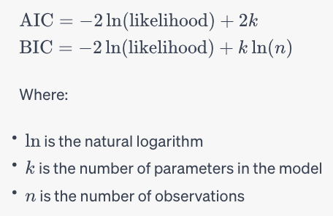
Assessment Statistics

Slide 8
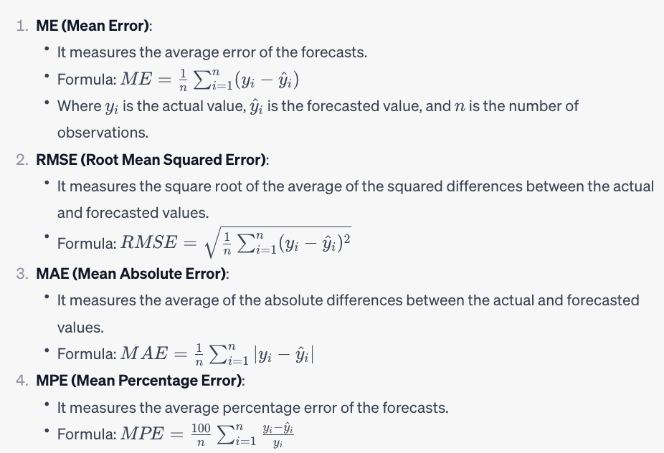
Assessment Statistics

Slide 9
Assessment Statistics

Slide 10
Assessment Statistics

Slide 11
Assessment Statistics

Slide 12
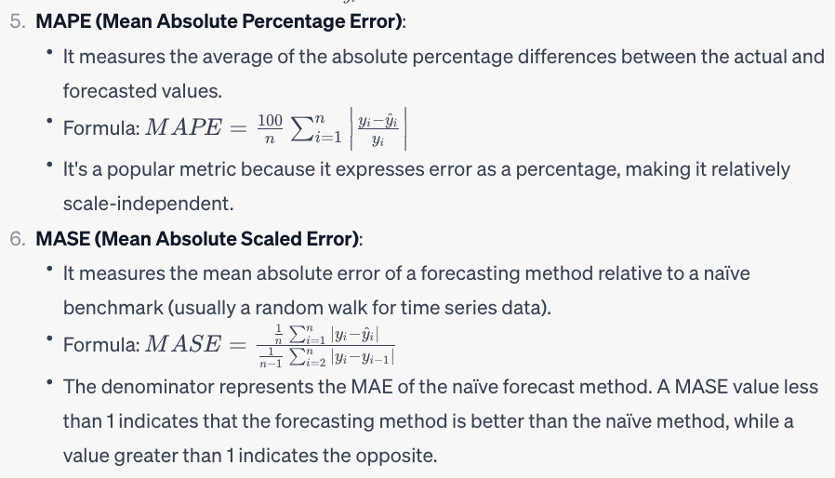
Assessment Statistics

Slide 13
Assessment Statistics

Slide 14
Assessment Statistics

